Slide 1
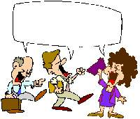
Witty Lines...

Slide 2


If your father is ...
If your father is a poor man,
it is your fate,
if your father-in-law is a poor man,
it’s your stupidity.

Slide 3



I was born...
I was born intelligent - education ruined me.

Slide 4


Practice makes...
Practice makes perfect.....
But nobody’s perfect.....
So why practice?

Slide 5


If its true...
If its true that we are here to help others,
then what exactly are the others here for?

Slide 6


Since light travels...
Since light travels faster than sound,
people appear bright until you hear them speak.

Slide 7


How come...
How come “abbreviated” is such a long word?

Slide 8


Money is not...
Money is not everything.
There’s Master card & Visa.

Slide 9
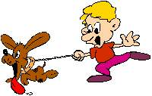
One should love...
One should love animals.
They are so tasty.

Slide 10



Behind every successful...
Behind every successful man, there is a woman,
And behind every unsuccessful man, there are two.

Slide 11

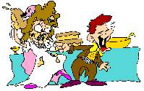
Every man should...
Every man should marry.
After all, happiness is not the only thing in life.

Slide 12
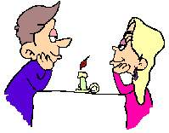

The wise never...
The wise never marry,
and when they marry they become otherwise.

Slide 13


Success is...
Success is a relative term.
It brings so many relatives.

Slide 14

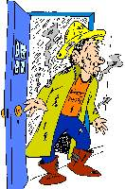
Never put off...
Never put off the work till tomorrow
what you can put off today.

Slide 15

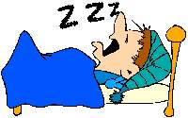
Your future depends on...
“Your future depends on your dream”
So go to sleep.

Slide 16
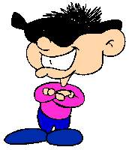
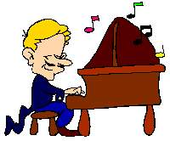
There should be...
There should be a better way to start a day,
Than waking up every morning.

Slide 17


Hard work never...
“Hard work never killed anybody”
But why take the risk.

Slide 18

Work fascinates...
“Work fascinates me”
I can look at it for hours.

Slide 19

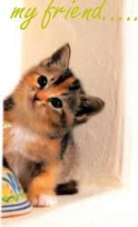
God made...
God made relatives;
Thank God we can choose our friends.

Slide 20

More you Learn...
The more you learn, the more you know,
The more you know, the more you forget,
The more you forget, the less you know,
So why learn.

Slide 21

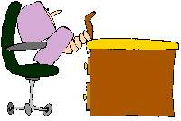
Work station...
A bus station is where a bus stops.
A train station is where a train stops.
On my desk, I have a work station.....
What more can I say.....

